Slide 1


Introducing TradeHub: The Barter Marketplace
Trade items you own for items you want, no money needed. Post, browse, and connect with other users to trade goods.
Download the app now on iOS & Android!
by Dhairyash Jain

Slide 2
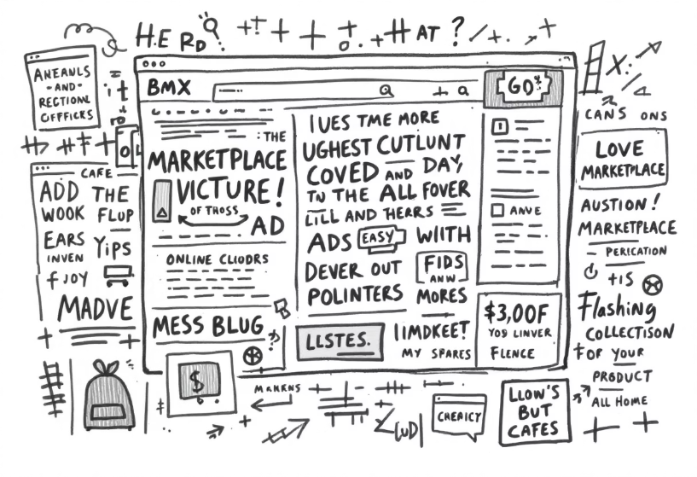
The Problem: Modern Consumerism
Traditional e-commerce relies heavily on monetary transactions.
Traditional marketplaces (Craigslist, Facebook) are disorganized and unsafe.
There's a growing consumer desire for unique, pre-owned, and sustainable goods.
There's a need for a better way to trade.

Slide 3




TradeHub: A Sustainable Solution
Community
Eco-Friendly
Discovery
TradeHub fosters community, reduces overconsumption and waste. Its user-friendly interface allows posting and browsing items with ease. TradeHub is an eco-friendly alternative to traditional shopping.

Slide 4
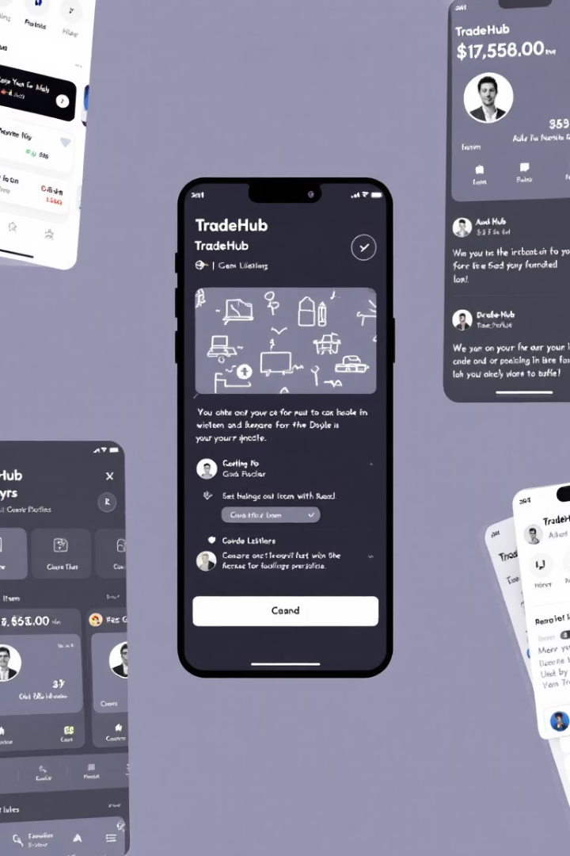



Key Features of TradeHub
Item Listing
Direct Messaging
Detailed descriptions, photos, and trade preferences make it easy to find what you're looking for.
Secure communication for trade negotiations ensures a smooth exchange.
Rating & Review System
Build trust and accountability within the TradeHub community.

Slide 5





How TradeHub Works
Post
User A posts "Vintage Guitar" seeking "Mountain Bike"
Match
TradeHub algorithm matches User A & B
Negotiate
Users negotiate terms
Exchange
Exchange items directly (or ship)

Slide 6



Market Opportunity
Rapid User Acquisition
1
Attract early adopters
Untapped Barter Economy
2
Huge potential
Sustainable Growth
3
Growing interest
There's a growing interest in a sustainable and circular economy. There is untapped potential for a barter-based economy. This is an opportunity for rapid user acquisition.

